Slide 1
Which firms are covered by financial analysts?
Current evidence from non-U.S. firms
Bianca Minuth
4th Assignment
Research on Corporate Transparency 7/17/2021

Slide 2
Data preparation
Selection of Compustat Global data for the fiscal years 2019 and 2020 (non-U.S. firms)
Number of unique analysts that issued an estimate for a given non-U.S. firm identified by its gvkey and I/B/E/S ticker in calendar year 2020
Since the Compustat Global dataset consists of variables shown in local currency exchange rates from WRDS were retrieved using the SAS code comp_exchange rates:
Daily exchange rate from comp.g_exrt_dly with GBP as benchmark currency to convert local currency to USD (Source: https://wrds-www.wharton.upenn.edu)
Retrieved for currency codes (curcd) in Compustat dataset
Exchange rate factor was multiplied with selected numeric values in the Compustat Global dataset (exchange rate: 1 unit local currency = x USD)
Fama-French Industry Classification (ff48)

Slide 3
Estimation
Analy_folw_ln = β₀size_ta + β₁ size_employ + β₂cap_intens + β₃rnd_intens + β₄liquidity + β₅roa + β₆leverage + µ
where*:
analy_folw_ln = log of number of analyst following a firm _{i}
size_ta = log of total assets
size_employ = number of epmloyees
cap_expend = capital expenditures to total assets
rnd_intens = research & development cost to total assets
liquidity = current assets to current liabilities
roa = net income to total assets
leverage = difference between long-term debt and debt in current liabilities to stockholders’ equity
(revenue growth = revenue _{t} to revenue _{t-1} -1)
µ for industry fixed effects (Fama-French 48 Industry Classification)
* Refer to Asquith et al. (2004), Lang et al. (2004), Bradshaw et al. (2016).

Slide 4
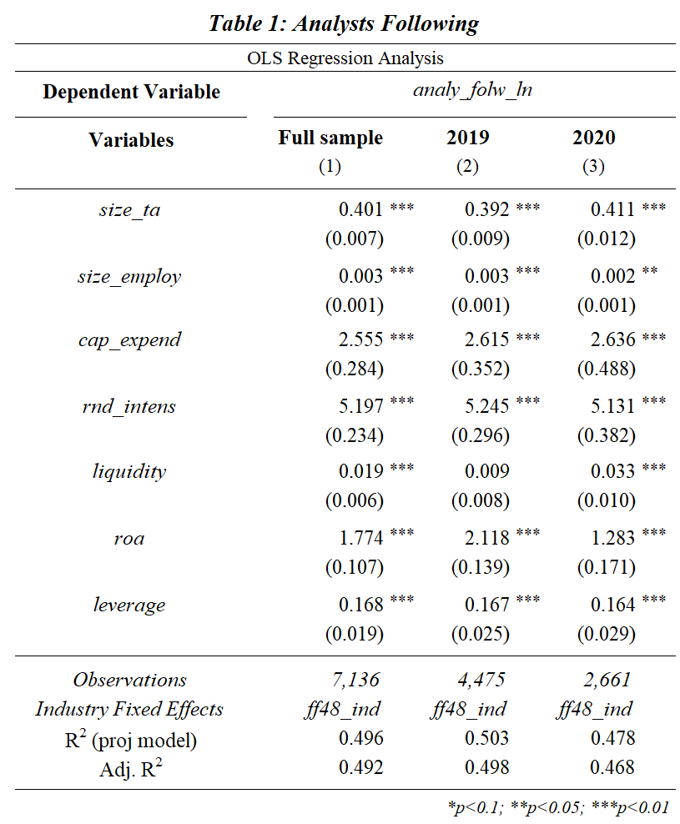
Results (1/2)
Table 1 shows the results using an OLS regression analysis after excluding outliers. [R code: ExPanD(df_sample_adj, cs_id = c("gvkey", "cname")]
The results for analyst following were shown for both firm years 2019 and 2020, to show potential differentiation between the two observation years, because the number of analyst following were retrieved only for 2020. In 2020, year-end financial information was only published for 2019, which could explain the slightly negative growth rate (Figure 6, slide 5) as well as the stable number of analysts following from 2019 in 2020.
Results are significant on a 1% level (except for size_employ 2020 and liquidity 2019.

Slide 5
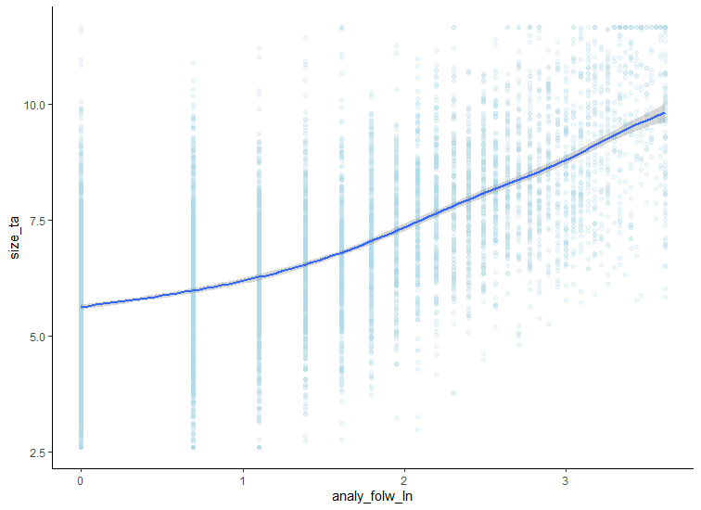
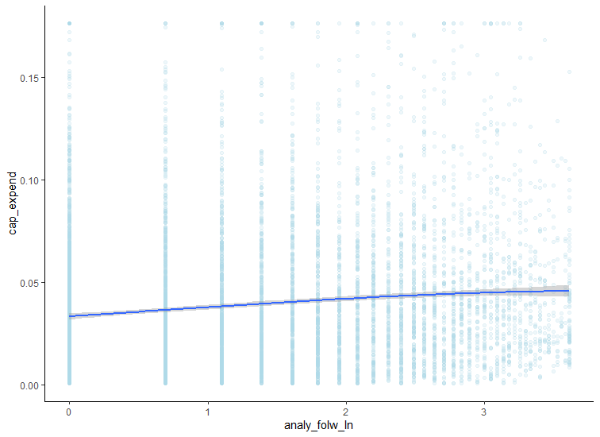
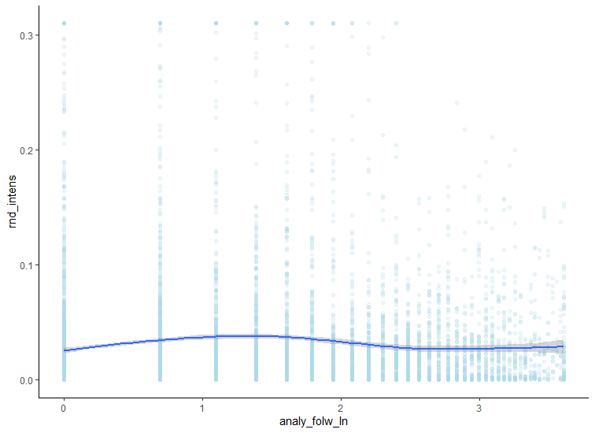
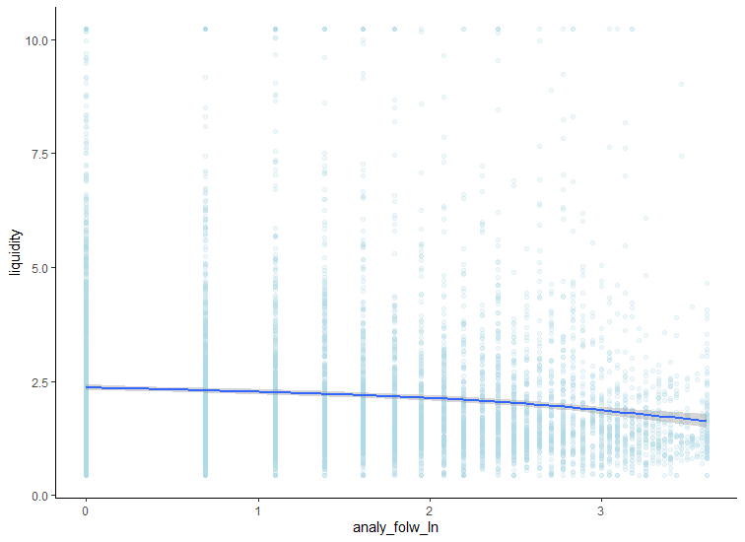
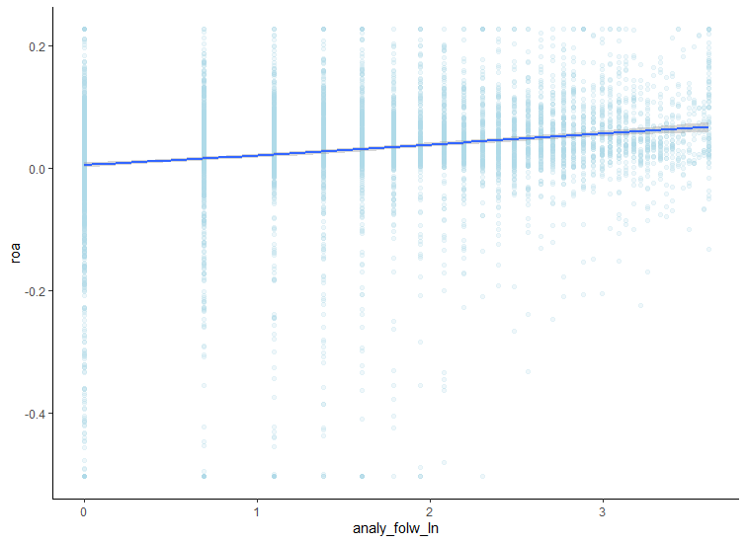
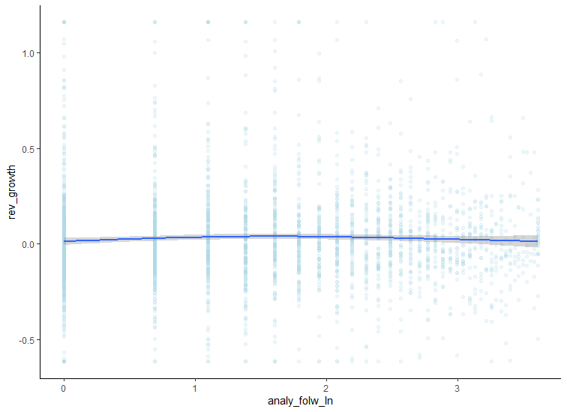
Results (2/2)
Figure 1
Figure 2
Figure 3
Cap_expend
Size_ta
rnd_intens
Analy_folw_ln
Analy_folw_ln
Analy_folw_ln
Figure 4
Figure 5
Figure 6
liquidity
roa
rev_growth
Analy_folw_ln
Analy_folw_ln
Analy_folw_ln

Slide 6
interpretation & Limitations
Interpretation of results
Analysts tend to follow firms
that are larger (size total assets, No. of employees)
with better liquidity ratios
and greater investment opportunities (capital expenditure)
that have higher expectations on profitability (roa) and innovation (rnd intensity).
Interestingly, the growth rate (rev_growth) was shown to be slightly decreasing with greater analyst following, but the growth rate was only calculated for one year and not on a long-term period.
Limitations
Focus on firms that have existing analyst coverage
Firm year observation only for 2019 & 2020
Growth rate estimation over a small period
Estimation could be extended on:
Ownership structure
Corporate governance environment
Level of disclosure
Country Fixed effects

Slide 7
References
Asquith, P., Mikhail, M. B., and Au, A. S., 2005. Information content of equity analyst reports. Journal of Financial Economics, 75 (2), pp. 245-282.
Bhushan, R., 1989. Firm characteristics and analyst following. Journal of Accounting and Economics, 11(2-3), pp. 255-274.
Lang, M.H., Lins, K.V., and Miller, D.P., 2004. Concentrated control, analyst following, and valuation: Do analysts matter most when investors are protected least? Journal of Accounting Research, 42 (3), pp. 589-623..
Mark Bradshaw, Yonca Ertimur and Patricia O’Brien, 2016.: Financial Analysts and Their Contribution to Well-Functioning Capital Markets, Foundations and Trends in Accounting, 11(3), pp. 119-191.
O'Brien, P.C. and Bhushan, R., 1990. Analyst following and institutional ownership. Journal of Accounting Research, 28 (Supplement), pp. 55-76.

